Slide 1
_{Analytical evaluation}

Slide 2
Aims:
Describe the key concepts associated with inspection methods.
Explain how to do heuristic evaluation and walkthroughs.
Explain the role of analytics in evaluation.
Describe how to perform two types of predictive methods, GOMS and Fitts’ Law.

Slide 3
Inspections
Several kinds.
Experts use their knowledge of users & technology to review software usability.
Expert critiques (crits) can be formal or informal reports.
Heuristic evaluation is a review guided by a set of heuristics.
Walkthroughs involve stepping through a pre-planned scenario noting potential problems.

Slide 4
Heuristic evaluation
Developed by Jacob Nielsen in the early 1990s.
Based on heuristics distilled from an empirical analysis of 249 usability problems.
These heuristics have been revised for current technology more recently, including:
  for web sites, mobile devices, wearables, virtual worlds, etc.
Design principles form a basis for developing heuristics.
Companies often develop their own, by augmenting Nielsen’s set.

Slide 5
Nielsen’s Original Heuristics
Visibility of system status.
Match between system and real world.
User control and freedom.
Consistency and standards.
Error prevention.
Recognition rather than recall.
Flexibility and efficiency of use.
Aesthetic and minimalist design.
Help users recognize, diagnose, recover from errors.
Help and documentation.

Slide 6
Budd (2007) for Web Design
Clarity: make the system as clear, concise and meaningful as possible for the intended audience:
    Write clear, concise text.
    Only use technical language for a technical audience.
    Write clear and meaningful labels.
    Use meaningful icons.
Minimise unnecessary complexity and cognitive load.
Provide users with context.
Promote a pleasurable and positive experience.

Slide 7
Discount Evaluation
Heuristic evaluation is referred to as discount evaluation when 5 evaluators are used.
Empirical evidence suggests that on average 5 evaluators identify 75-80% of usability problems.

Slide 8
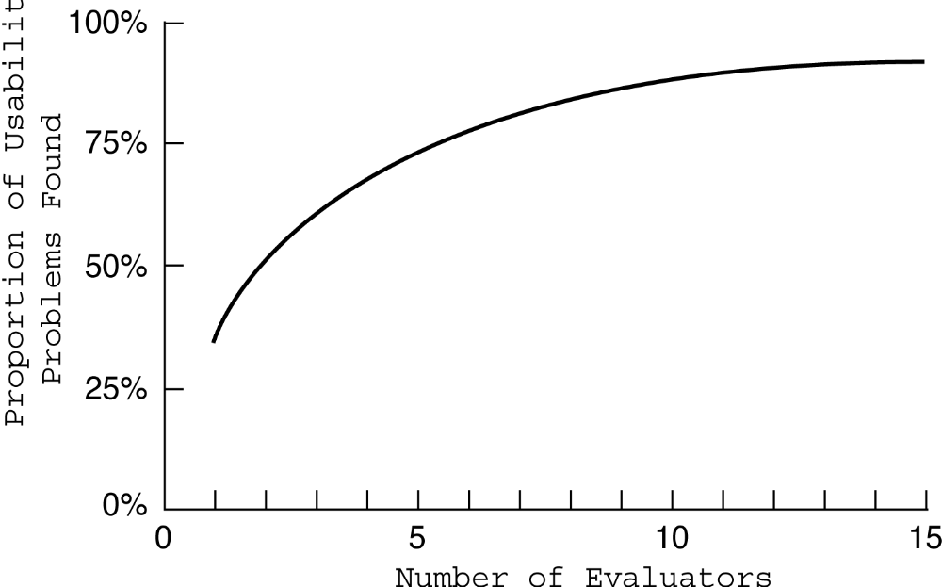
No. of evaluators & problems
www.id-book.com

Slide 9
3 stages for doing Heuristic Evaluation
Briefing session to tell experts what to do.
Evaluation period of 1-2 hours in which:
  Each expert works separately;
  Take one pass to get a feel for the product;
  Take a second pass to focus on specific features.
Debriefing session in which experts work together to prioritize problems.

Slide 10
Advantages and Problems
Few ethical & practical issues to consider because users not involved.
Can be difficult & expensive to find experts.
Best experts have knowledge of application domain & users.
Biggest problems:
  Important problems may get missed;
  Many trivial problems are often identified;
  Experts have biases.

Slide 11
Cognitive walkthroughs
Focus on ease of learning.
Designer presents an aspect of the design & usage scenarios.
Expert is told the assumptions about user population, context of use, task details.
One or more experts walk through the design prototype with the scenario.
Experts are guided by 3 questions.

Slide 12
The 3 questions
Will the correct action be sufficiently evident to the user?
Will the user notice that the correct action is available?
Will the user associate and interpret the response from the action correctly?
As the experts work through the scenario they note problems.

Slide 13
Pluralistic walkthrough
Variation on the cognitive walkthrough theme.
Performed by a carefully managed team.
The panel of experts begins by working separately.
Then there is managed discussion that leads to agreed decisions.
The approach lends itself well to participatory design.

Slide 14
A project for you …
http://www.id-book.com/catherb/
provides heuristics and a template so that you can evaluate different kinds of systems.
More information about this is provided in the interactivities section of the id-book.com website.

Slide 15
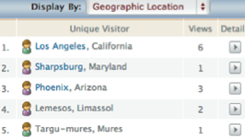
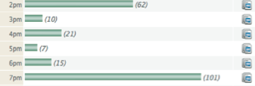
Analytics
A method for evaluating user traffic through a system or part of a system
Many examples including Google Analytics, Visistat (shown below)
Times of day & visitor IP addresses

Slide 16
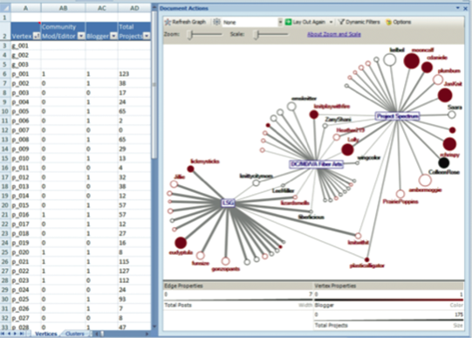
Social action analysis
(Perer & Shneiderman, 2008)

Slide 17
Predictive Models
Provide a way of evaluating products or designs without directly involving users.
Less expensive than user testing.
Usefulness limited to systems with predictable tasks - e.g., telephone answering systems, mobiles, cell phones, etc.
Based on expert error-free behavior.
No experts mimicking users, no analytics of use.
Instead analyses tasks and keystroke patterns.

Slide 18
GOMS
Goals – what the user wants to achieve e.g. find a website.
Operators - the cognitive processes & physical actions needed to attain goals, e.g. decide which search engine to use.
Methods - the procedures to accomplish the goals, eg. drag mouse over field, type in keywords, press the go button.
Selection rules - decide which method to select when there is more than one.

Slide 19
Example GOMS model
Goal: to delete a word in a sentence.
Method using menu option:
  Step 1: Recall that word to be deleted has to be highlighted.
  Step 2: Recall that command is ‘cut’
  Step 3: Recall that command ‘cut’ is in edit menu.
  Step 4: Accomplish goal of selecting and executing the cut command.
  Step 5: Return with goal accomplished.
Method using delete key…<>
Operators:
  Click mouse
  Drag cursor over text
  Select menu
  Move cursor to command
  Press key
Selection rules:
  Delete text using mouse and selecting from menu if a large amount of text is to be deleted.
  Delete text using delete key if a small number of letters are to be deleted.

Slide 20
Keystroke level model
GOMS has also been developed to provide a quantitative model - the keystroke level model.
The keystroke model allows predictions to be made about how long it takes an expert user to perform a task.

Slide 21
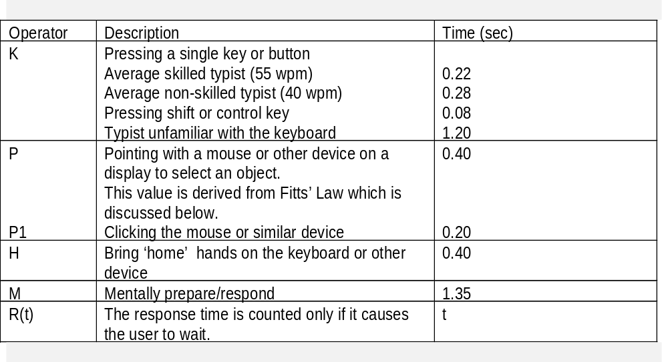
Response times for keystroke level operators (Card et al., 1983)

Slide 22
Summing together

Slide 23
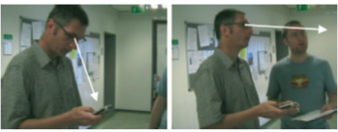
Using KLM to calculate time to change gaze (Holleis et al., 2007)

Slide 24
Fitts’ Law (Fitts, 1954)
Fitts’ Law predicts that the time to point at an object using a device is a function of the distance from the target object & the object’s size.
The further away & the smaller the object, the longer the time to locate it & point to it.
Fitts’ Law is useful for evaluating systems for which the time to locate an object is important, e.g., a cell phone, a handheld devices.

Slide 25
Key Points
Inspections can be used to evaluate requirements, mockups, functional prototypes, or systems.
User testing & heuristic evaluation may reveal different usability problems.
Walkthroughs are focused so are suitable for evaluating small parts of a product.
Analytics involves collecting data about users activity on a website or product
The GOMS and KLM models and Fitts’ Law can be used to predict expert, error-free performance for certain kinds of tasks.

